Slide 1
Data Analysis for transaction dataset
By
Sravanya Majeti

Slide 2
Data preparation
The dataset contains 12043 transactions for 100 customers who have one bank account each.
Transactional period is from 01/08/2018 - 31/10/2018 (92 days duration).
The data entries are unique and have consistent formats for analysis.
Some columns contain missing data , which is likely due to the nature of transaction.
It is also noticed that there is only 91 unique dates in the dataset,
suggesting the transaction records for one day are missing (turned out to be 2018-08-16).

Slide 3
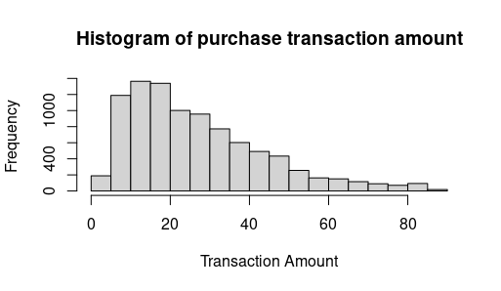

Slide 4
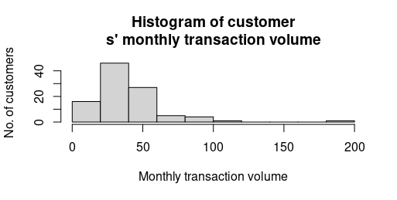

Slide 5
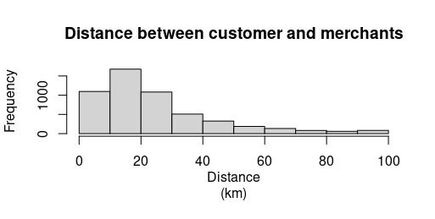

Slide 6
